Slide 1
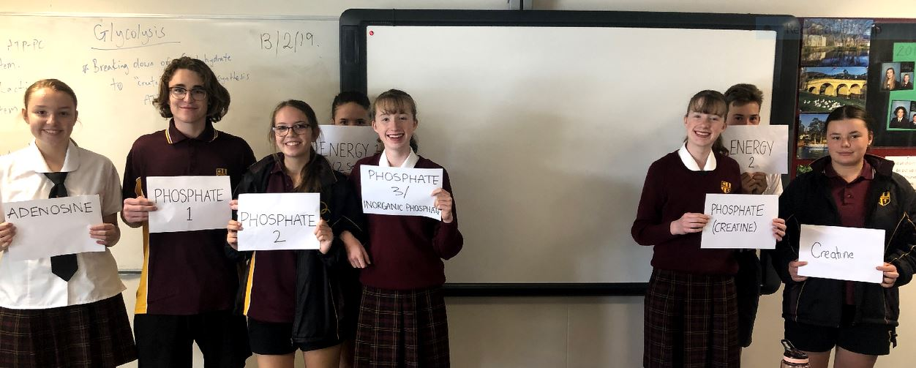
Sport Science

Slide 2
Grade 9 and 10 Sport Science
This is a two year course which can be chosen as an elective in Years 9 and/or 10.
This is an academic, theory based subject which provides students with the opportunity to develop an understanding of the physiological and psychological aspects of sport.
Students are provided with the opportunity to develop an understanding and appreciation of the importance of physical fitness and nutrition for optimum sporting performance.
Students will increase their knowledge of the theory and practice of performance in sport. It is recommended that students have a sound background in Science and are passionate about Sport and Performance.

Slide 3
Why Should I take Sport Science
Students who have an interest in developing an understanding of the importance of physical activity, sport, recreation and fitness in their lives as well as an understanding of how the body functions and the factors that influence sporting performance.
Student who are interested in opportunities to apply theory in a practical context through participating.
Practical aspects of the course encompass popular sports and recreational activities.
Topics promote a healthy lifestyle, understanding of biology and the impact the brain has on performance.

Slide 4
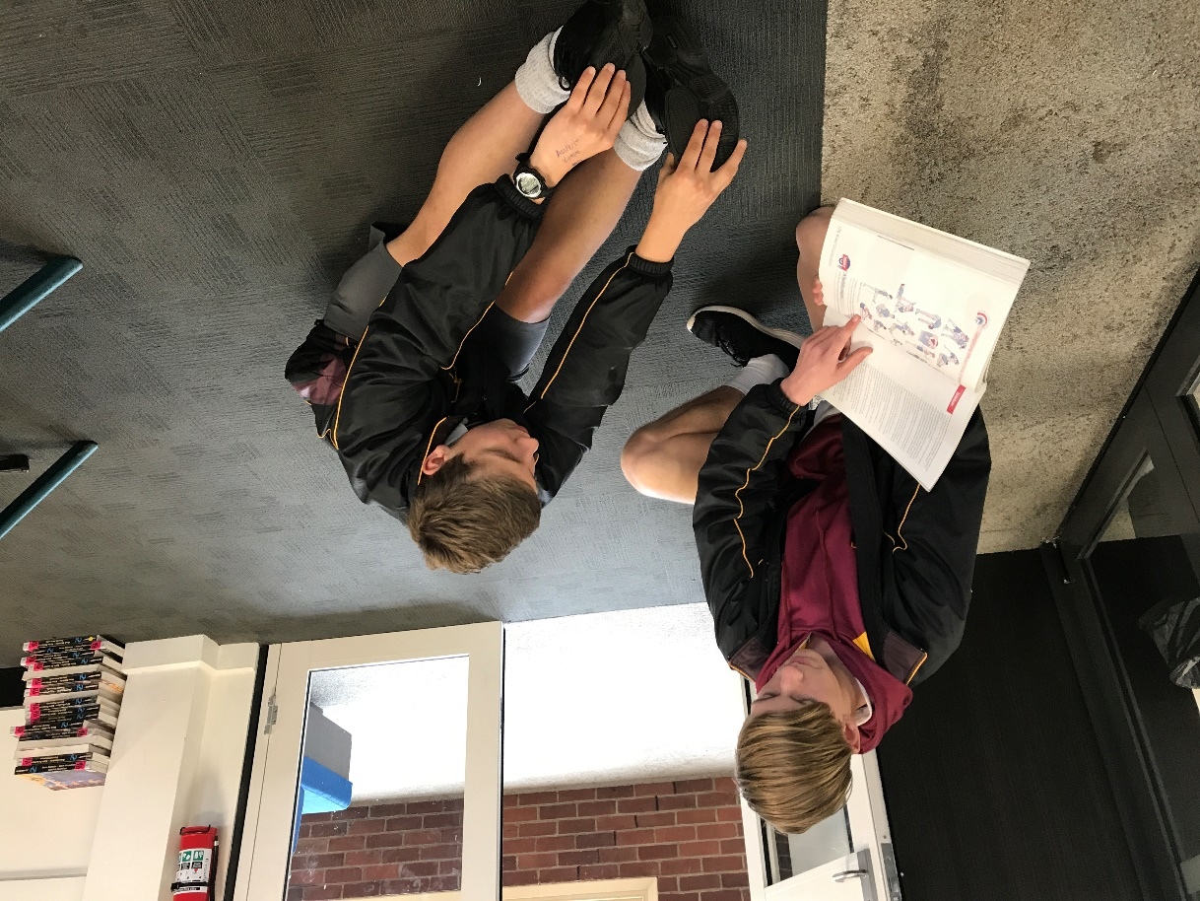
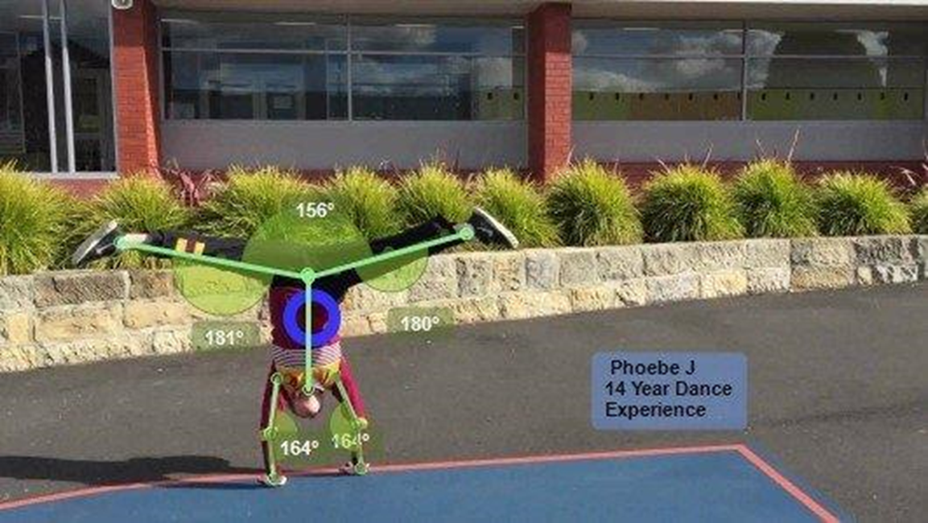
Sport Science Careers
Health Work
Massage Therapy
Sports Medicine
Physiotherapy
Tourism
Teaching
Sports Administration
Sport Psychology
Sports Coaching
Recreational Programs
Fitness Training / Personal Trainer
Naturopathy
Nutritional Consultancy
Health Promotion & Information

Slide 5
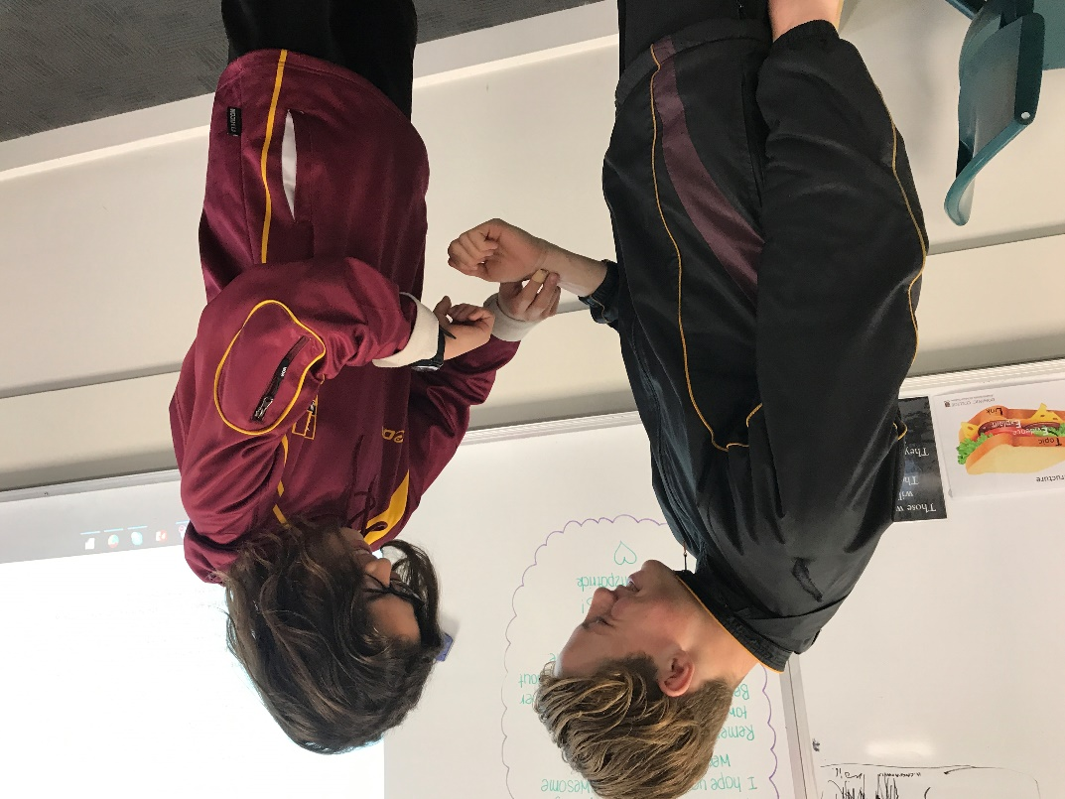
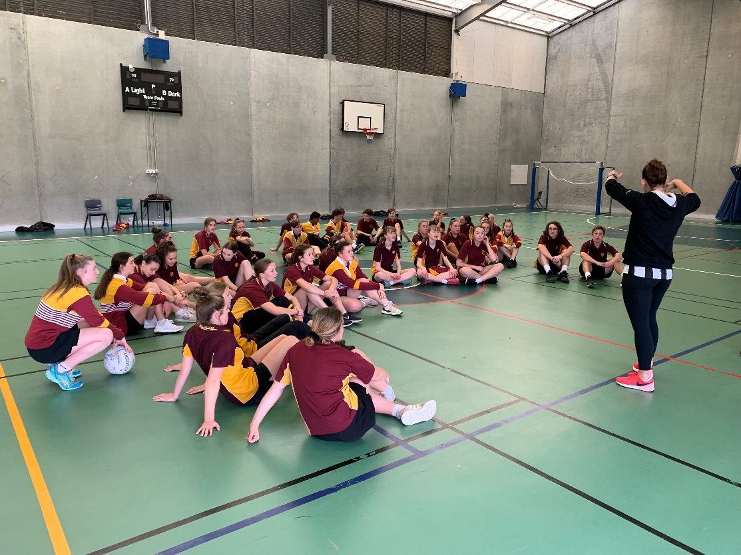
Topics Covered
Energy Systems
Body Systems
Sport Psychology
Training Principles / Types
Skill Acquisition & Coaching
Nutrition
Bronze Medallion
Drugs in Sport
First Aid
Biomechanics of sport

Slide 6
Engaging Activities
Study the treatment of sports injuries
Learn about body systems and how they are interrelated
• Study the benefits of fitness and the health and skill related components
• Look at the role and function of nutrients in improving diet and athletic performance
• Study and practice different training techniques used in fitness programs
• Research current events and social issues eg. Olympic games, drugs in sport;
• Study the use of energy systems in sport
• Learn how a skill is acquired
• Research factors which affect children in sport
• Look at the different roles of the coach as well as coach a sport
• Study psychological factors which affect sporting performance
• Study biomechanics in sport
• Analyse games

